Slide 1
Predicting Car Accident Severity
D a t a S c i e n c e C a p s t o n e P r o j e c t
Prabal Ganguly

Slide 2
I n t r o d u c t i o n
Predicting car accidents and its severity would help to bring down the death toll:-
Globally, road car crashes are a leading cause of death among young people
.Analysing various factors like weather conditions, locality, type of road and lighting might help in the prediction.
On Accurate predictions proactive steps can be taken to recover from the situation.
Lots of lives may be saved if accurate prediction allows emergency services to be implemented quickly and efficiently

Slide 3
Data Management
The raw data was collected from 5 different data sets and then data cleaning was performed on then :-
The characteristics,places,user, vehicle, holiday data has been collected from https://www.kaggle.com/ahmedlahlou/accidents-in-france-from-2005-to-2016
Duplicate, highly similar or highly correlated features were dropped.
Initial analysis of the data for the selection of the most relevant features for this specfic problem, reduced the number of features of of the dataset from 54 to 28.

Slide 4
Methodology/Exploratory Data Analysis
First, the distribution of the target's values was visualized. The plot confirmed that it is a balanced labeled dataset as the samples are divided 56-54 with more cases of lower severity.
Then a seasonality analysis was performed, visualizing the global trend of daily accidents as well as the amount of accidents grouped by years, month of the year, and day of the week.

Slide 5
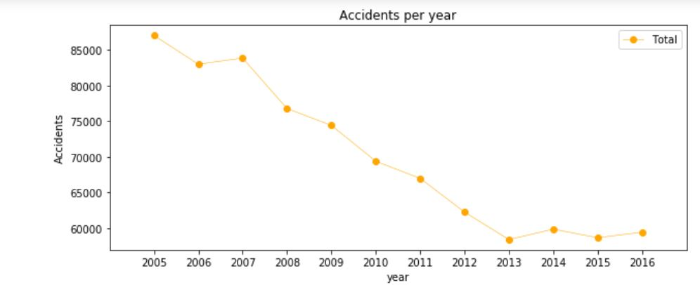
Line Plot of Total Accidents Per Year

Slide 6
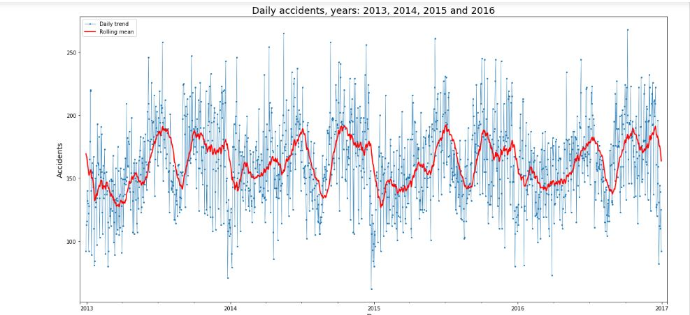
The number of accidents decreased over the year 2005 -2013 after which the trend became stable

Slide 7
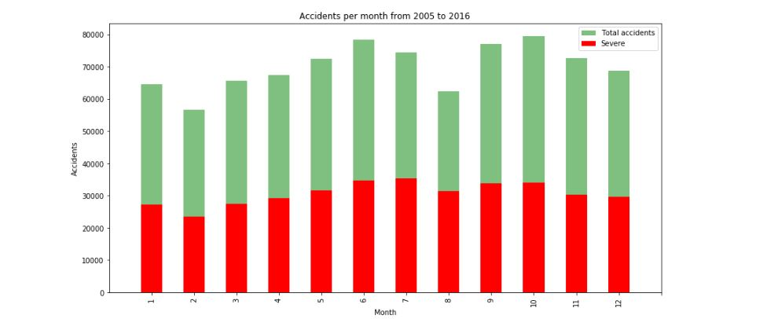
Accidents increase from March to June and then again in September, decreasing at the end of the year

Slide 8
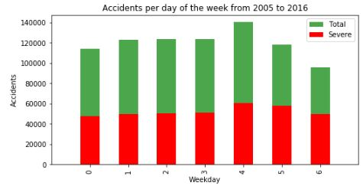
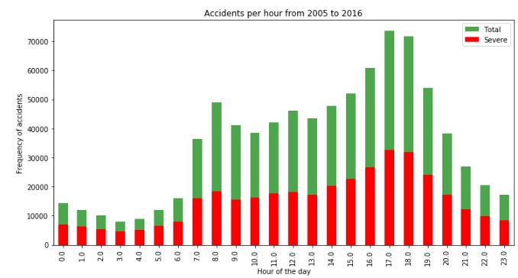
Weekly data shows most accidents on Friday and on a week day most accidents are at 8AM and 5-6PM

Slide 9
Classification Models
Random Forest:10 decision trees, max depth of 12 features
Logistic Regression: c=0.001
K-Nearest neighbour: K=16
Supervised Vector Machine

Slide 10
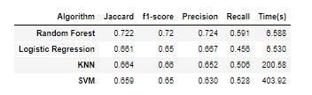
Results
This Table Reports the evaluation of each model:-

Slide 11
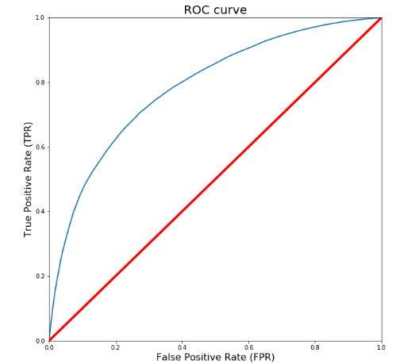
As evident from the results Random Forest is the best model.

Slide 12
Conclusion
Built useful model to predict severity of car accidents and also pointed out the time to avoid it and for the authorities to expect it.
I was able to achieve 68%accuracy however I think the model would perform better if the condition of the cars and festivals would have been taken into account.
Moreover the target here was kept binary labelling severity within a range would have allowed application of Regression model.

